Slide 1


Corona Virus
Data Analysis Using SQL
By Lancelot Uwagboe

Slide 2
C O N T E N T
I N T R O D U C T I O N
D A T A O V E R V I E W
S Q L Q U E R I E S C O N C L U S I O N

Slide 3
Introduction
The COVID-19 pandemic, caused by the novel coronavirus SARS-CoV-2, has dramatically reshaped the global landscape, affecting billions of lives worldwide. Since its emergence in late 2019, the pandemic has posed unprecedented challenges to public health systems, economies, and societies across the globe. With its rapid spread and profound impact, understanding the trajectory and dynamics of the pandemic becomes paramount in navigating through these challenging times.
In this presentation, we delve into the data-driven insights obtained from comprehensive SQL analyses, shedding light on key aspects of the pandemic's progression, including infection rates, mortality patterns, recovery trends, and the broader societal implications.

Slide 4

Data Overview
Description of each column in the dataset:
Province: Geographic subdivision within a country/region.
Country/Region: Geographic entity where data is recorded.
Latitude: North-south position on Earth’s surface.
Longitude: East-west position on Earth's surface.
Date: Recorded date of CORONA VIRUS data.
Confirmed: Number of diagnosed CORONA VIRUS cases.
Deaths: Number of CORONA Virus-related deaths.
Recovered: Number of recovered CORONA VIRUS cases.

Slide 5

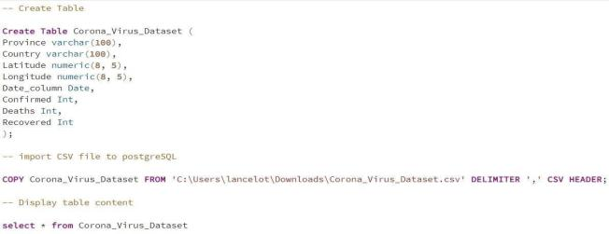
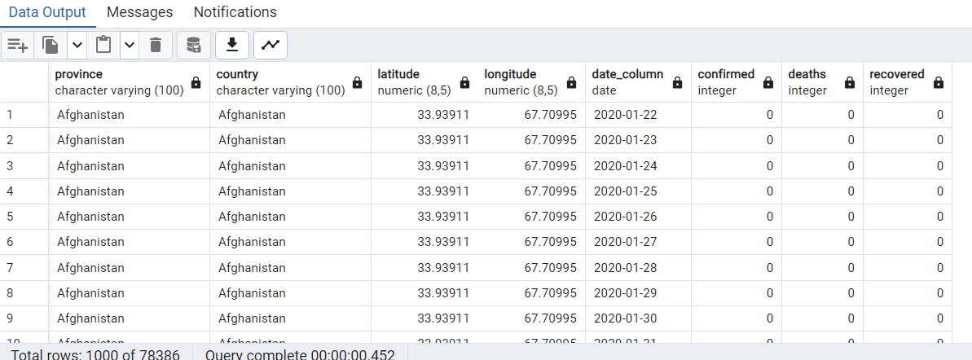
SQL Query
Create Table, Import, and View CSV File

Slide 6
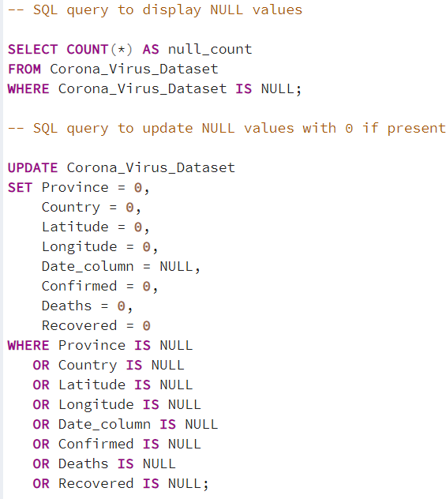
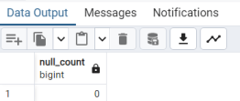



SQL Query contd.
Query for NULL values, and update NULL values with 0

Slide 7

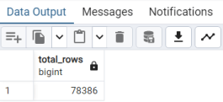
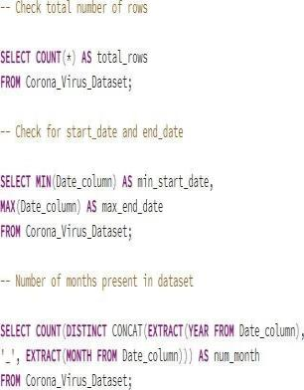
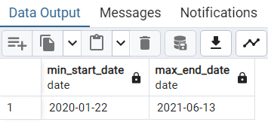
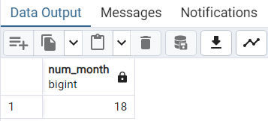
SQL Query contd.
Query the Total number of rows, Start & End date, and Number of Months in the Dataset

Slide 8
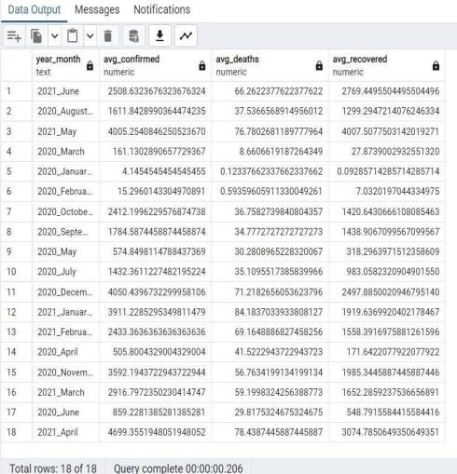
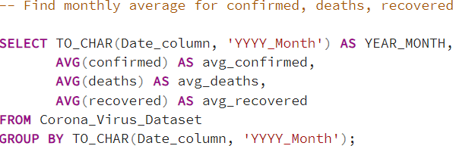

Monthly Average for Confirmed, Death and Recovered Cases

Slide 9
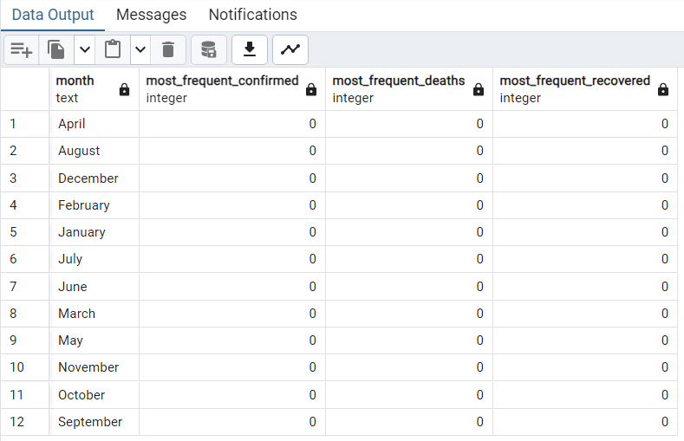
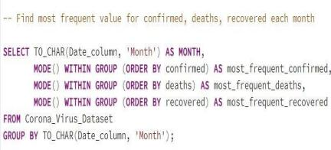

Most Frequent Value for Confirmed, Death, and Recovered Cases

Slide 10

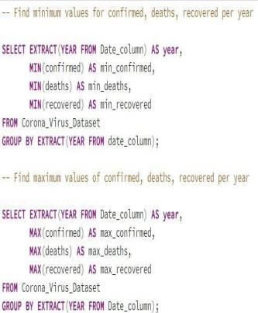
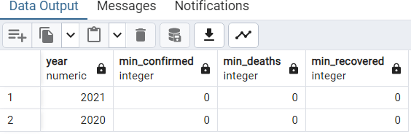
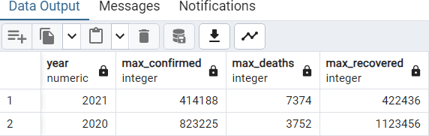
Minimum & Maximum Value for Confirmed, Death, and Recovered Cases

Slide 11
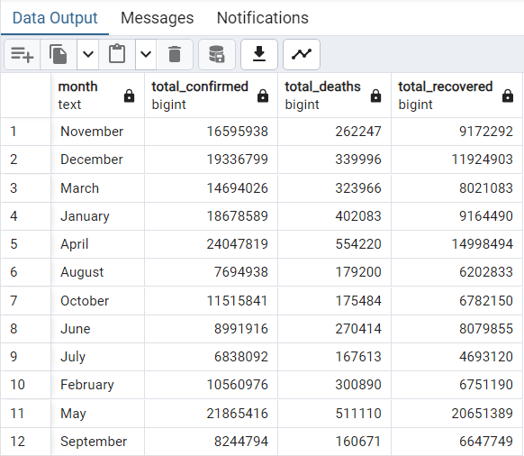
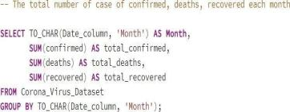
Total Number of Confirmed, Death, and Recovered Cases

Slide 12
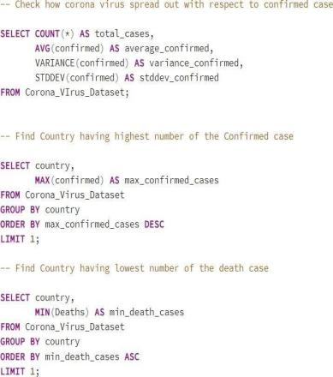
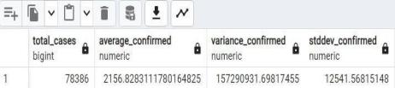
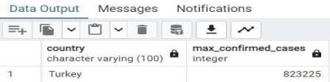
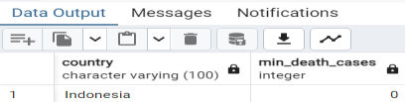
Corona Virus Spread Analysis for Confirmed, Death, and Recovered Cases
Virus spread for Confirmed cases, Country with Highest number of Confirmed and Lowest Death

Slide 13
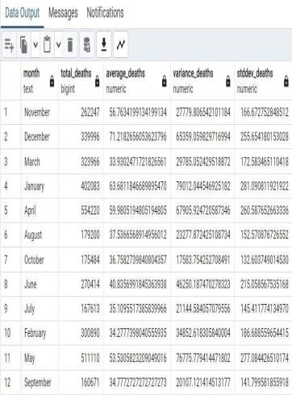
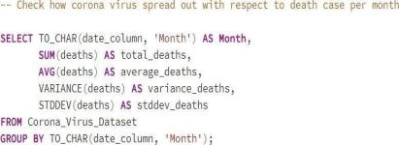
Corona Virus Spread Analysis for Death Cases Per Month

Slide 14
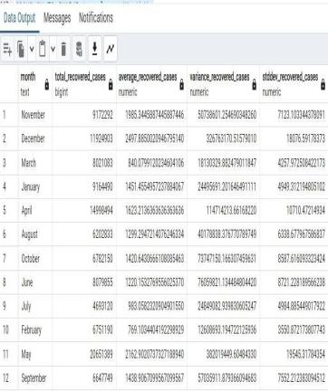
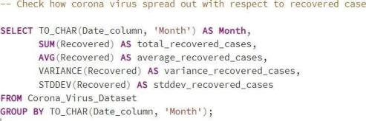
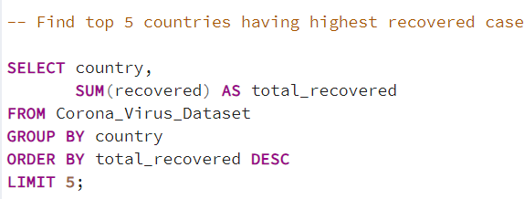
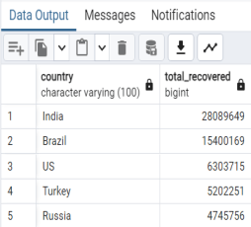
Corona Virus Spread Analysis for Recovered Cases Per Month
Top 5 Countries With the Highest Recovered Cases

Slide 15


C o n c l u s I o n
15
min
In conclusion, our analysis of the COVID-19 pandemic data provides valuable insights into its multifaceted impact on global health, economies, and societies. Through rigorous examinations, we have gained a deeper understanding of the pandemic's dynamics and the Challenges it has posed.
As we reflect on the lessons learned and strategies for future preparedness, it becomes evident that data-driven insights play a crucial role in informing evidence-based decision-making and guiding effective responses to public health crises. Moving forward, continued collaboration, innovation, and adaptation will be essential in navigating the complexities of the pandemic landscape and building resilient systems to safeguard global health and well-being.

Slide 16


